Slide 1

Introduction to SQL & Database Design
WEEK 1 · SQL TRAINING FOR BEGINNERS
Oyelaran Paul Temitope
Saturday, 7 November 2026
Notes:
Welcome to Week 1. Introduce yourself, the weekly 30-minute format, and the goal: help every business professional get comfortable asking questions of data with SQL.

Slide 2
What We Cover in Week 1
TODAY'S SESSION
1
2
3
What is SQL?
Databases & the DBMS
SQL vs NoSQL
The language of relational databases and what it lets you do.
Where data lives and the software that manages it.
Two families of databases and when each one fits.
4
5
Design & key terms
Keys, constraints & types
Entities, attributes, relationships and the vocabulary.
Rules that keep data accurate and connected.
Notes:
Five short blocks. The course runs in two parts: Part 1 Foundations (today) and Part 2 Querying & advanced SQL (filtering, joins, grouping, set operations, conditional logic, subqueries, CTEs, string and date functions). Every concept is paired with a short real query. No prior SQL experience assumed.

Slide 3
What Is SQL?
THE BASICS
Structured Query Language (SQL) is the standard language for storing, retrieving and managing data in relational databases.
1
Store
Keep data organised in tables.
2
Retrieve
Ask questions and get back exactly the data you need.
One transferable skill across finance, healthcare, retail and tech.
3
Manage
Keep data accurate and up to date.
Notes:
SQL (Structured Query Language) is a standardized programming language used to manage relational databases and perform operations on the data in them. It is used everywhere, from small business apps to Fortune 500 systems: if a relational database sits behind it, SQL is how people talk to it.

Slide 4
Databases and the DBMS
FOUNDATIONS
Users & applications
DBMS
Database
People and programs that ask questions of the data.
The software in between: storage, retrieval, security, performance, backup and recovery.
An organised collection of structured data, stored electronically.
Notes:
A database is an organized collection of structured information, or data, typically stored electronically in a computer system and usually controlled by a database management system (DBMS). Together, the data, the DBMS and the applications associated with them are referred to as a database system, often shortened to just 'database'. The DBMS is the interface between the database and its end users or programs, allowing users to retrieve, update and manage how information is organised and optimised. It also handles oversight and administration such as performance monitoring, tuning, and backup and recovery. Popular examples: MySQL, Microsoft Access, Microsoft SQL Server, Oracle Database, PostgreSQL.

Slide 5







SQL vs NoSQL
TWO FAMILIES OF DATABASES
SQL (Relational)
VS
NoSQL (Non-relational)
Structure
Table-based, with predefined relationships.
Structure
Flexible and schema-less; handles unstructured data.
Best for
Rigid structures, e.g. financial transactions.
Best for
Fast-changing data, e.g. social media.
Same student data, stored as rows and columns
Same student data, stored as JSON documents
id | name | surname | age
1 | John | Brown | 19
2 | Emma | Carly | 23
[ { "id": 1, "name": "John",
"surname": "Brown", "age": 19 },
{ "id": 2, "name": "Emma",
"surname": "Carly", "age": 23 } ]
SQL brings structure. NoSQL brings flexibility.
Notes:
Relational (SQL): data is organised in predefined relationships and stored in one or more tables (relations) of columns and rows, which makes it easy to see how different data structures relate. Relationships are logical connections between tables. Non-relational (NoSQL): no tabular schema of rows and columns; storage is optimised for the type of data, for example key/value pairs, JSON documents, or a graph of edges and vertices. A flexible data model is ideal for data that changes frequently or for diverse types of data.

Slide 6
How to Design a Database
PLANNING FIRST
Plan the structure before the data arrives, the way you would plan the fields of a registration form.
1
2
3
4
Identify your entities
Choose data types
Name things clearly
Think in records & fields
What tables does the system need? A school needs Students, Teachers and Classes.
Decide whether each field is text, a number, a date or an image.
Be consistent and readable, e.g. tblStaff, emp_firstName.
A record is one row (one employee). A field is one column (their email).
Know your data upfront. Design is a team effort: developers, analysts and business experts.
Notes:
Database design is the careful planning of the layout that will hold the data your application collects, like deciding the fields on a registration form. Know what kind of data you are collecting (text, numbers, dates, images) so the structure fits it. Good design usually needs collaboration between developers, analysts and the people who understand the business.

Slide 7
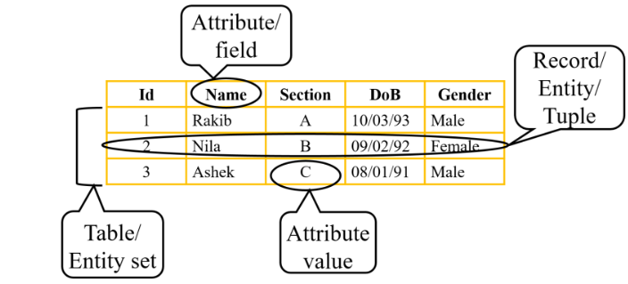
Entities, Attributes and Relationships
BUILDING BLOCKS
Entities/Table
A real-world thing with distinct characteristics: Customer, Product, Student.
Attributes
The properties that describe an entity: a Customer has CustomerID, Location and Email.
Relationships
How entities connect: one-to-one (husband and wife) or one-to-many (mother and children).
An ER diagram is a visual map of entities, attributes and the relationships between them.
Notes:
ER diagram: a visual representation of how data relates. In the ER model we break data into entities and attributes and set up relationships between entities; all of this can be shown visually in an ER diagram. Reference used in the original slides: https://www.edupointbd.com/database-model-ev/

Slide 8
Key Terms You'll Hear Often
VOCABULARY
Table / Entity
Record (row)
Field (column)
Key
Where data about one real-world thing is stored, in rows and columns.
One complete entry, like a single customer.
One attribute of an entry, like an email address.
An attribute (or set) that uniquely identifies a row and links tables.
Schema
Relationship
ER diagram
Bit & byte
The overall logical blueprint of how data relates in a database.
A link between entity types, such as one-to-many.
A visual map of entities, attributes and relationships.
A bit is the smallest unit of data. 8 bits make 1 byte, enough for one character.
Notes:
File: a group of related records, often classified by the application it serves (an employee file). A primary key in a file is the field (or fields) whose value identifies a record among others. Tuple is another word for a row in a relation (table).

Slide 9
Keys: Linking Your Tables
RULES FOR YOUR DATA
Customer (parent)
Order (child)
Primary key
Name
OrderID
PK
Uniquely identifies each row. One per table, though it can span several columns.
CustomerID
PK
CustomerID
FK
Email
OrderDate
Foreign key
Illustration: every order must point to a customer that exists.
Links a child table to a parent table's primary key and enforces referential integrity.
A primary key names each row. A foreign key points to it from another table.
Auto-increment
Generates a unique number automatically for every new record.
Notes:
Primary keys uniquely identify a record in a table. A table may only have one primary key, though it can span several columns. Foreign keys define the relationship between two tables: the parent table has a primary key that uniquely identifies its rows, and the child table holds that value in one of its columns. A FOREIGN KEY ... REFERENCES constraint ensures values in the child table must exist as a primary key value in the parent. Auto-increment generates a unique number automatically when a record is inserted, and is often used for the primary key. The customer/order tables on this slide are an illustration, not from a real database. Next slide: the wider family of constraints.

Slide 10
SQL Constraints
RULES FOR YOUR DATA
Constraints are rules on a table's columns that limit what data can go in. If an action breaks a rule, SQL aborts it.
PRIMARY KEY
FOREIGN KEY
NOT NULL
Uniquely identifies each row. One per table.
Links to a row in another table, so no order can point to a missing customer.
The field cannot be left empty. NULL means empty is allowed.
CustomerID INT PRIMARY KEY
REFERENCES Customer(CustomerID)
Email VARCHAR(100) NOT NULL
UNIQUE
CHECK
DEFAULT
Every value in the column must be different.
Only values that meet a condition are accepted.
Fills in a value automatically when none is provided.
Email VARCHAR(100) UNIQUE
Age INT CHECK (Age >= 18)
Qty INT DEFAULT 1
Notes:
Constraints specify rules for the data in a table and limit the type of data that can go in. This keeps the data accurate and reliable. If there is any violation between a constraint and a data action, the action is aborted. Primary key and foreign key were covered on the previous slide. NOT NULL and NULL control whether a field may be left empty. UNIQUE keeps every value different. CHECK restricts values to ones that meet a condition. DEFAULT fills in a value when none is provided. The SQL snippets are short examples to read aloud, not from a real database.

Slide 11
Common Data Types
CHOOSING THE RIGHT TYPE
Numeric
Date & time
Character & string
Counts, quantities, prices, phone numbers
Dates, clock times, timestamps
Names, emails, free text
INT
DATE
TIME
CHAR
VARCHAR
DECIMAL
DATETIME
TEXT
FLOAT
Before you build a table, decide for every field: is it text, a number or a date?

Slide 12
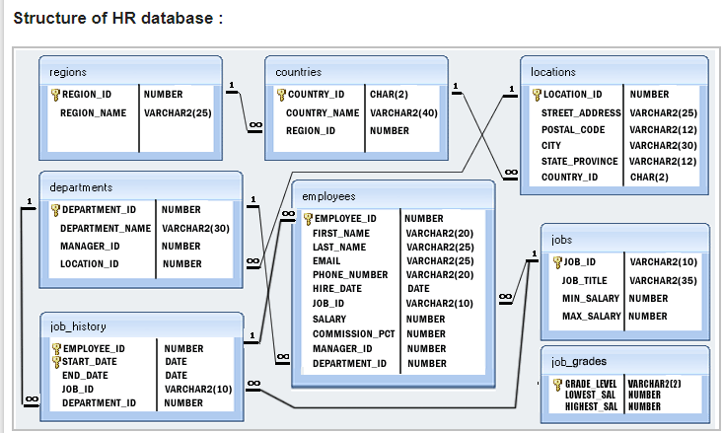
A Sample Database: HR
SEEING IT IN PRACTICE
1
Each box is a table
Its fields are listed inside, with their data types.
2
The key icon marks the primary key
It uniquely identifies every row in that table.
3
Lines are relationships
1 means one, the infinity sign means many.
Notes:
The HR sample database links regions, countries, locations, departments, employees, jobs, job history and job grades. Use it to point out primary keys (key icon), data types, and the one-to-many relationships drawn between tables.

Slide 13

Week 1 Recap
SQL is the standard language for relational databases: query, insert, update and delete data.
1
A DBMS sits between users and the database and keeps it running.
2
Good design starts with entities, attributes and relationships.
3
Questions?
4
Keys and constraints keep data accurate and connected.
Thank you for joining. See you next Saturday at 5:00 PM WAT.
Oyelaran Paul Temitope

